Slide 1
CNN Based Federated Learning for Breast Cancer Diagnosis using Ultrasound images
Group 41:
Fatema Tuj Jahura (23366007)
Ripa Sarkar (23366009)
Raisa Hasan Bushra (23366014)
Tasnim Fuyara Chhoan (23366035)
Course Instructor: Annajiat Alim Rasel
Mehnaz Ara Faizul (ST)
Humaion Kabir Mehedi (RA)

Slide 2
Introduction:
Analysis of ultrasound images for breast cancer detection
Proposed tools:
Federated Learning (FL)
Convolutional Neural Networks (CNN)
Integration of CNN-based federated learning for breast cancer diagnosis
Addressing the challenges of centralizing sensitive medical data while improving diagnostic accuracy with the help of Machine Learning (ML)

Slide 3
Reasons Behind Choosing the Research Topic
In earlier researchers CNN and Federated learning model had applied separately to diagnose breast cancer, brain cancer, tumors.
CNNs are most commonly used tools for breast cancer diagnosis because of their capability to learn and analyze complex features from images and adaptation to diverse datasets.
Federated learning utilizes diverse, decentralized data sources and enables collaborative learning for creating a strong deep learning model.
Conjunctively, these two powerful models can make a promising approach for improving the accuracy and efficiency of breast cancer diagnosis.
Using the ultrasound image data allows for more comprehensive understanding of breast lesions.

Slide 4
Proposed Methodology
Breast Ultrasound Images Dataset
Dataset Loading and Conversion
Data segmentation - 70% training, 30% validation
Training CNN model and Training Transfer Learning CNN models
Result analysis for each models
Apply CNN model and another Average Transfer Learning model (best 2/3)
Result analysis for both case
Apply Transfer learning for both
Compare and Evaluate
Analysis Accuracy and Decide
Diagnose Breast Cancer using most accurate model

Slide 5
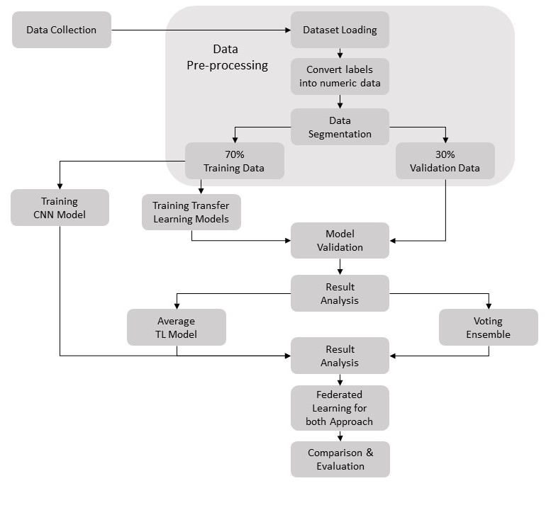

Slide 6
Future Scopes
Improved model performance
Large scale deployment
Integration with clinical workflow
Multi model fusion

Slide 7
Conclusion
The integration of CNN and Federated Learning (FL) for breast cancer detection using ultrasound images offers a promising solution to the challenges of centralized medical data. Leveraging the strengths of CNNs for intricate feature analysis and FL for collaborative learning from decentralized datasets, this approach aims to enhance diagnostic accuracy. Through meticulous dataset handling, model training, and result analysis, the combined model demonstrates potential for improved breast cancer diagnosis. The emphasis on large-scale deployment, integration with clinical workflows, and multi-model fusion underscores its practical applicability and holistic diagnostic capabilities.

Slide 8
References
[1] Tan, Y. N., Tinh, V. P., Lam, P. D., Nam, N. H., & Khoa, T. A. (2023). A Transfer Learning Approach to Breast Cancer Classification in a Federated Learning Framework. IEEE Access, 10.1109/ACCESS.2023.3257562.
[2] Abdul Salam, M., Taha, S., Ramadan, M. (2021). COVID-19 detection using federated machine learning. PLoS One, 16(6): e0252573. https://doi.org/10.1371/journal.pone.0252573.
[2] Gao, T. (2020). Chest X-ray image analysis and classification for COVID-19 pneumonia detection using Deep CNN. Preprint. Health Informatics. https://doi.org/10.1101/2020.08.20.20178913.
[3] Wu, T., Tang, C., Xu, M., Hong, N., Lei, Z. (2021). ULNet for the detection of coronavirus (COVID-19) from chest X-ray images. Computers in Biology and Medicine, 137: 104834. https://doi.org/10.1016/j.compbiomed.2021.104834.
[4] Wu, T., Tang, C., Xu, M., Hong, N., Lei, Z. (2021). ULNet for the detection of coronavirus (COVID-19) from chest X-ray images. Computers in Biology and Medicine, 137: 104834. https://doi.org/10.1016/j.compbiomed.2021.104834.

Slide 9
THANK
YOU

